Slide 1

CEIR Stock Management Feature - Training Manual

Slide 2

Agenda
Feature Overview
Stakeholder Overview
State Diagram
UI Walk Thru
View All Stock
View A Stock
Upload Stock
Assign Stock
Anonymous Stock Upload
Withdraw Stock
Edit Stock
Approve Stock
Reject Stock

Slide 3


Feature Overview
Stock Management Feature allows user to upload their
SIM based devices into the CEIR system. The stock
details for device can be uploaded using this feature
Stock Management Feature is used in following cases:
Importer wants to upload stock in grace period
Distributor wants to upload stock
Retailer wants to upload stock
Manufacturer wants to upload fresh stock
Custom wants to assign stock to distributor/retailer once auction is completed
Anonymous user wants to upload stock in grace period to avoid any unforeseen challenges (Unregistered User)
Importers
Manufacturer
Distributor
CEIR Admin
Retailer
Custom

Slide 4

User Flow – Importer, Distributor and Retailer
Typical flow is as follows:
User place an order to supplier
Supplier provide the device details to user
User receive the delivery of device along with device details
User upload device details on CEIR Portal
CEIR Admin approves the device details
Importers
Distributor
Distributor
CEIR Admin
Retailer
Retailer

Slide 5
User Flow – Custom
Typical flow is as follows:
Custom has confiscated some consignment from importer due to tax not paid issue or importer did not came to collect the device within stipulated time
Custom auctions the devices. Distributor / Retailer participate in auction
Any Distributor/ Retailer bid and win the auction
Custom assigns the devices to Distributor/Retailer using CEIR Portal
Once assigned, the stock is visible in Distributor/Retailer panel as well
CEIR Admin approves the device details
Normally such devices are assigned to importer within CEIR portal. Custom should request CEIR admin to withdraw the consignment so that device are removed from the name of importer before the auction.
Importers
Custom
CEIR Admin
Distributor
Retailer

Slide 6
User Flow – Manufacturer
Typical flow is as follows:
Manufacturer is a legal entity allowed to manufacture devices in Cambodia
Manufacturer request TAC from GSMA
Manufacturer produce devices and want to sell them in Cambodia
Only devices intended to be sold in Cambodia, should be uploaded on CEIR portal
Manufacturer upload the device on CEIR Portal
CEIR Admin approves the device details
Manufacturer
CEIR Admin

Slide 7
User Flow – Anonymous User
Typical flow is as follows:
Importer / Retailer / Distributor has stock available during grace period that need to be uploaded on CEIR system
Importer / Retailer / Distributor do not want to disclose their identity
As a measure to build maximum whitelist database of device within country (active and inactive), this option is provided.
User goes to the DMC Home Portal
Select Stock Upload Option
Upload the Stock
CEIR admin approve the stock
Importer/
Retailer/
Distributor
CEIR Admin

Slide 8
Feature Impact
Use Case | Impact | Remarks
Stock Upload By Manufacturer | High | Manufacturer is one of the key source of IMEI information and the device information provided is used as whitelisted database in the CEIR system. The impact is high, though there is no local manufacturer in the country as of now.
Stock Assignment by Custom | High | There is a high chance that auctioned devices are not part of tax paid database as importer has not paid taxes on these devices. If custom does not upload the stock, there will be no information regarding duty paid for the said devices. In that case, the end user will not be able to use the devices after CEIR system implementation.
Stock upload by Importer/ Retailer/ Distributor | High during grace period Low during post grace period | In case Importer/Retailer/Distributor does not upload stock in grace period and the devices are not valid, then the same will be blocked after grace period is over when found to be used in the network by end-user. All invalid devices uploaded by user during grace period will be allowed to be used in network forever.

Slide 9
Stakeholder Overview
S.No. | User | Key Feature
1 | Importer/ Retailer/ Distributor/ Manufacturer | Upload Stock
2 | CEIR Admin | Approve Stock
3 | Customs | Assign stock after auction

Slide 10
State Transition – Overview - Stock
User
System
CEIR Admin
INIT
PROCESSING
Pending for CEIR Approval
Approved
Upload
System
Process
System
Process
Approve
Stock State under various Stakeholder
System
Process
Edit
Reject
Rejected by System
Edit by Importer
Edit
Rejected by
CEIR Admin

Slide 11
State Transition - Overview
Stock State | Meaning
New | Importer/Retailer/Distributor/Manufacturer/Custom uploaded a new stock
Processing | The system has started the processing of this stock
Rejected by system | The system has found an error, most likely in the file format, file data, file size, policy-based errors
Approval pending from CEIR Admin | The file processing is successful, stock upload request is accepted and now it is sent to CEIR Admin for approval
Rejected by CEIR Admin | CEIR has rejected the stock upload.
Withdrawn by User | User has withdrawn the stock upload.
Withdrawn by CEIR Admin | CEIR Admin has withdrawn the stock upload.
Approved | CEIR Admin approves the stock upload

Slide 12
UI – Overview - Feature
S.No. | Feature | Stakeholder
1 | View all stocks (Only those that are pending for action by user) | Importer/ Retailer/ Distributor/Manufacturer/ Custom, CEIR Admin
2 | Upload Stock | Importer/ Retailer/Distributor/Manufacturer
3 | Assign Stock | Custom
3 | Approve Stock | CEIR Admin
4 | Reject Stock | CEIR Admin
5 | Edit | Importer/ Retailer/ Distributor/ Manufacturer/ Customs
6 | Delete (Withdraw) | Importer/ Retailer/ Distributor/Manufacturer/ Customs/CEIR Admin
7 | View | Importer/ Retailer/ Distributor/ Manufacturer/ Customs/CEIR Admin
8 | History | Importer/ Retailer/ Distributor/ Manufacturer/ Customs/CEIR Admin

Slide 13
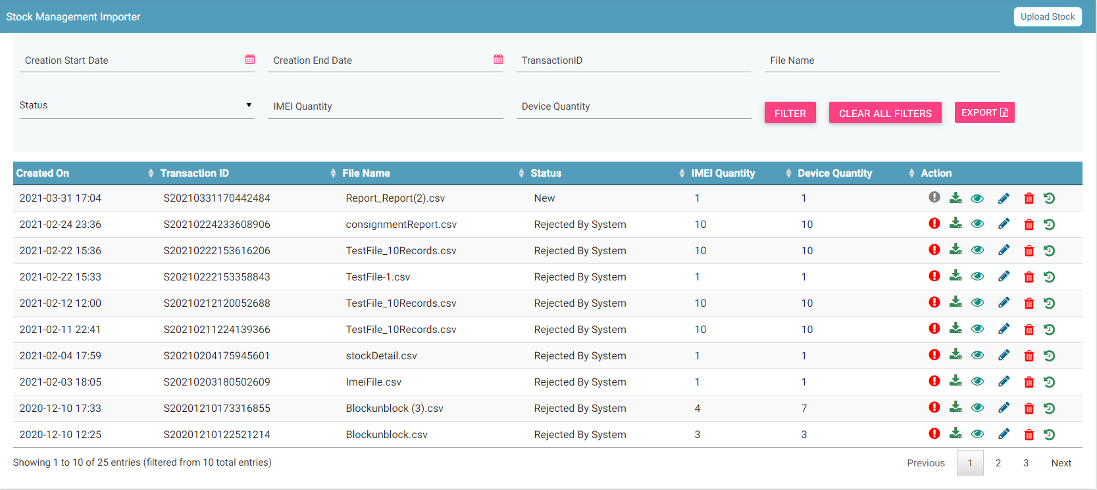
Stock Management – User
Filters
Export
Upload
Action like View, Delete
View All Stocks

Slide 14
Stock Management – User
Stock management home page is same for Importer/ Retailer/ Distributor/ Manufacturer/ Custom/ CEIR Admin
All records which are uploaded by the user will be displayed in their respective home page.
CEIR admin will be able to view all records using the filter option but only the records with status “APPROVAL PENDING FROM CEIR ADMIN” will be displayed on the home page by default.
Stock feature will not be available for Importer after the grace period is over.
Stock can be uploaded anonymously also by the end-user.
By default, the data displayed is sorted in descending order on last modified date.
Data can be sorted based on other fields by clicking the arrow buttons on the column headers. On first click, data will be sorted in ascending order. On second click, it will be sorted in descending order.

Slide 15
Action List
Action are enabled / disabled based on the state of the stock.

Slide 16
Actions Enabled/ Disabled for User
Disabled actions are greyed out.

Slide 17
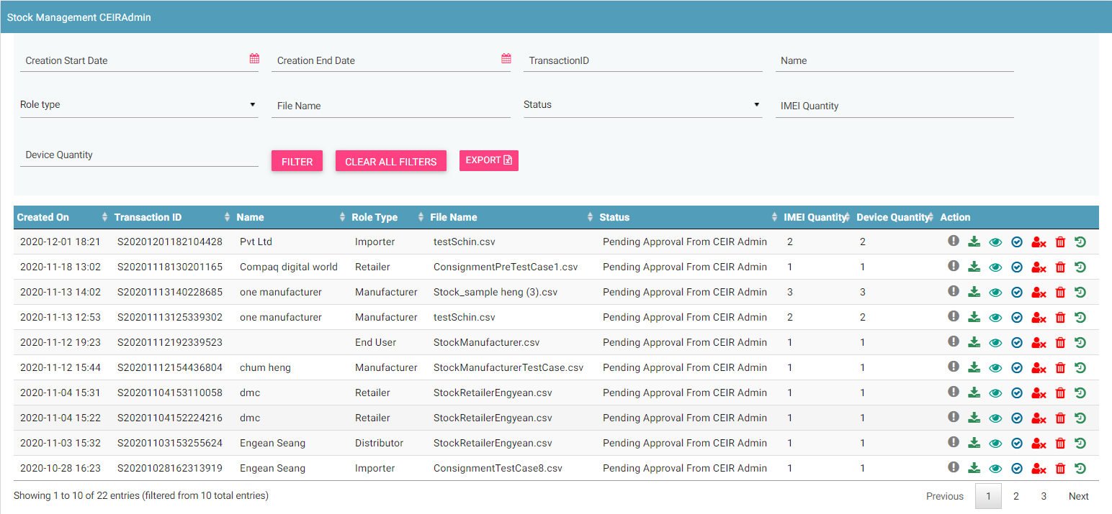
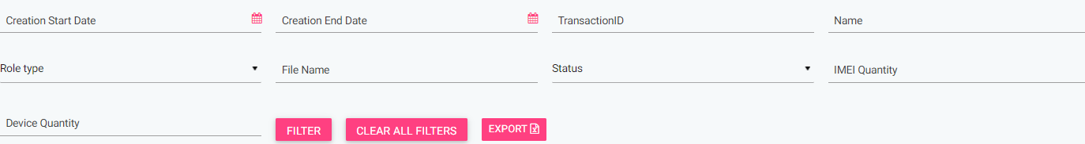
CEIR Admin Portal
By default, stock with status “Approval pending from CEIR Admin” will be displayed in the CEIR Admin queue.
In case CEIR Admin wishes to view stock in any other state, they can use the filter options to display the same.

Slide 18
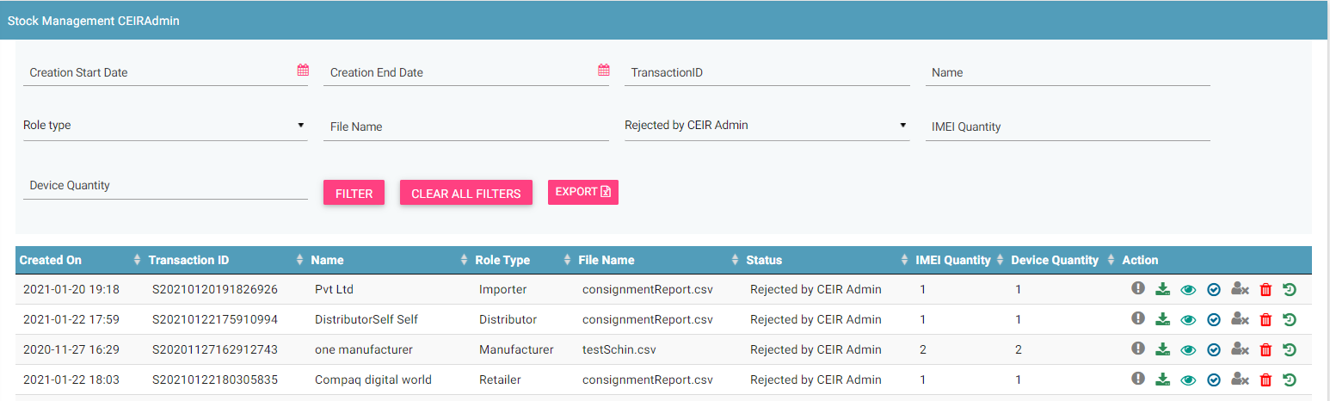
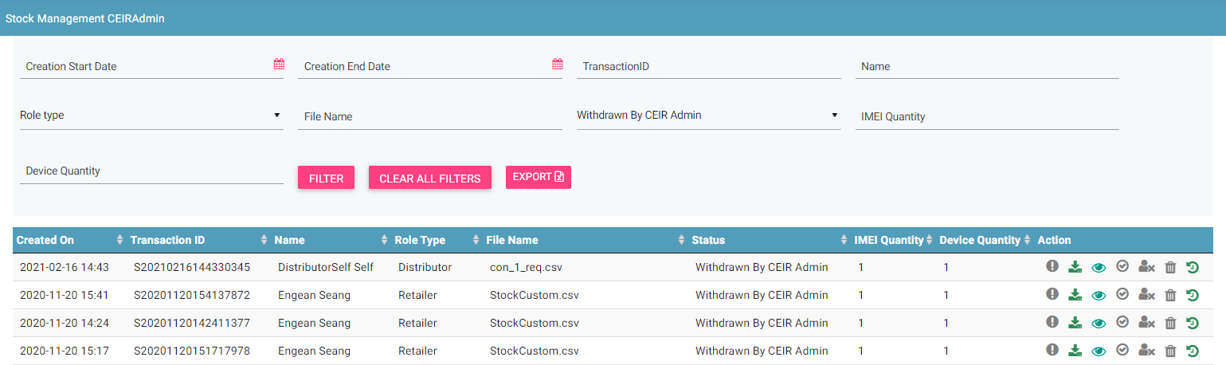
CEIR Admin Portal (contd.)
For stock status APPROVAL PENDING FROM CEIR ADMIN, actions like Download, View, Approve, Reject, History and Withdraw all will be enabled for CEIR Admin.
For stock status REJECTED BY CEIR ADMIN , actions like Download, View, Approve, History and Withdraw will be enabled for CEIR Admin.
For stock status WITHDRAWN BY CEIR, only Download , History and View option will be enabled for CEIR Admin.
All other states will have only View option enabled for CEIR Admin.

Slide 19
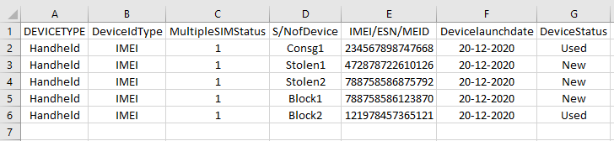
Stock Flow
User uploads a stock.
In order to upload a stock, a user needs to furnish the following details:
→ Supplier id → Supplier name
→ Quantity → Invoice number
→ Bulk stock information
A unique Transaction ID is generated for each new stock which is uploaded. This transaction id can be used in future for raising grievance (if any) regarding the stock upload. The transaction ID will be used for tracking the stock at any state. Status = NEW
User implies Importer/ Distributor/ Retailer/ Manufacturer/Custom

Slide 20
Stock Flow ( contd..)
System processing is being done at the backend. Status = PROCESSING
In case the stock is rejected by system. Status = REJECTED BY SYSTEM
System rejects the stock in case there is some issue with the format of the file uploaded or any policy violation is done. The format of the file is available for download on the upload stock screen.
After successful internal processing, the stock is sent to the CEIR Admin queue for Approval/ Rejection. Status = APPROVAL PENDING FROM CEIR ADMIN.
CEIR Admin approves the stock. Status = APPROVED. Email is sent to user and CEIR Admin. Notifications is also displayed on the user dashboard.
CEIR Admin rejects the stock. Status = REJECTED BY CEIR. Email is sent to user and CEIR Admin. Notifications is also displayed on the user dashboard.
CEIR Admin can also withdraw stock. Status = WITHDRAWN BY CEIR.
User can also withdraw stock when it is in either NEW/ REJECTED BY SYSTEM state.
Status = WITHDRAWN BY USER

Slide 21
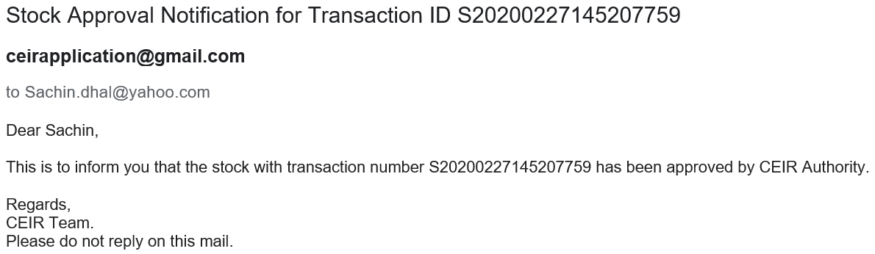
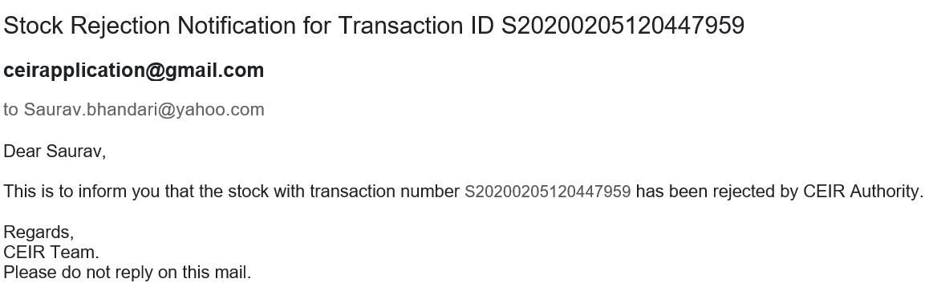
Email samples
Approved by CEIR
Rejected by CEIR
Email contents can be configured from the System Admin portal. This will be explained in detail in the system configuration training.

Slide 22
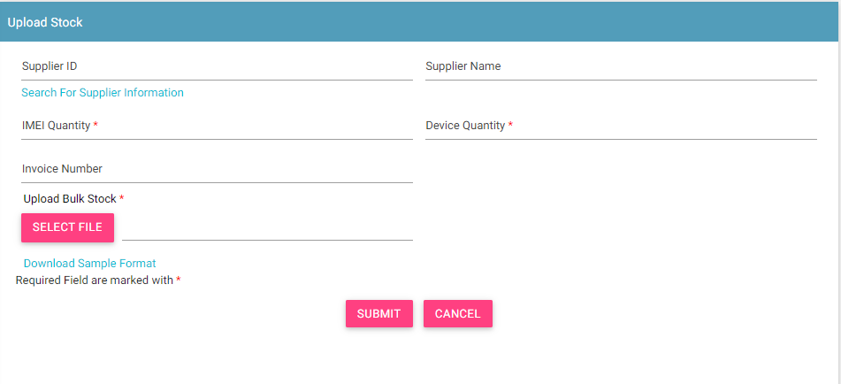
Upload Stock
Some Rules to Follow
For manufacturer, there is no supplier and there would be no invoice as well. So the form does not contain these field
For distributor, the supplier would be a importer, manufacturer or other distributor
For retailer, the supplier would be a importer, manufacturer, distributor or other retailer
For Custom, the stock can be assigned to user who has role as distributor or retailer or both.
To upload the file, use the system format. For any confusion, download the sample format.

Slide 23
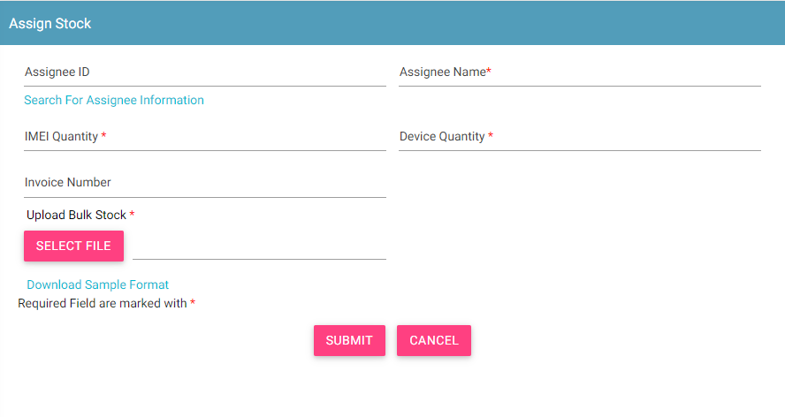
Assign Stock
Only custom user is allowed to assign stock.
For searching the user information

Slide 24
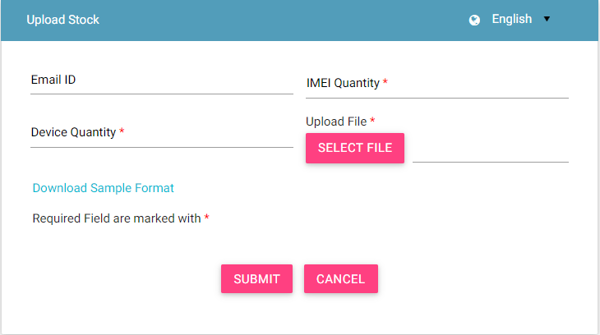
Anonymous upload of Stock
End-user can upload stock using the Anonymous stock upload option available in the DMC home page.
No personal details will be asked for in case the user wants to hide his /her identity.
Email id is provided if the user wants to get an update for the stock. But that is not mandatory.

Slide 25
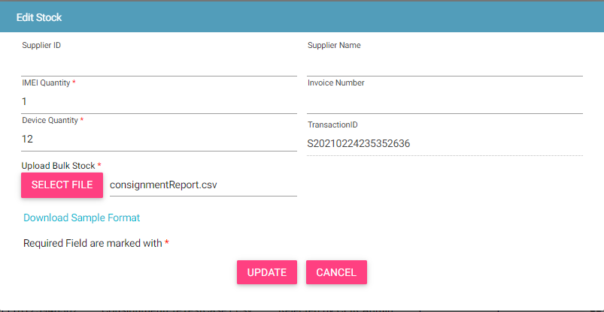
Edit Stock
Only allowed in rejected states
Rejected By System
Rejected By CEIR Admin
Edit By User
NEW
Stock moved back to NEW state

Slide 26
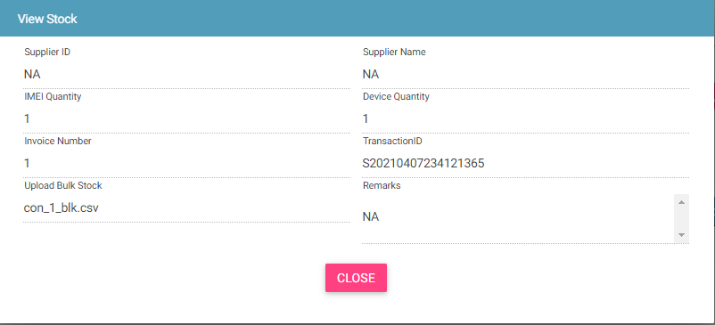
View Stock
Who all can view the stock?
Importer
Retailer
Distributor
Manufacturer
CEIR Admin
Custom
This screen is not editable. This is just to view the details filled in by the user.

Slide 27
System Processing
All NEW stock will be processed in FIFO order by the system
Once the processing starts, the status is changed to PROCESSING to indicate that work is in progress
Once the processing is complete, the status is changed to either REJECTED_BY_SYSTEM or SUCCESS (APPROVAL_PENDING_FROM_CEIR_ADMIN)
Post processing an e-mail notification is sent to user in case of REJECTED_BY_SYSTEM and in case of SUCCESS email is sent to both user and CEIR Admin.

Slide 28
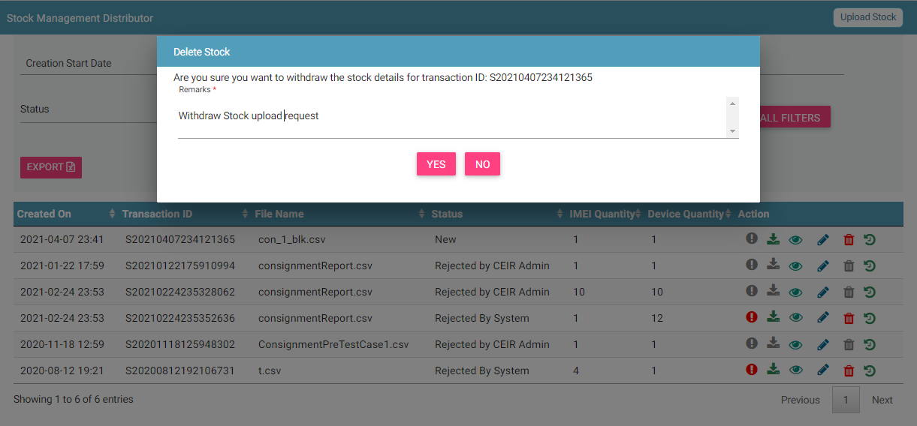
Stock Withdrawn By User
User can withdraw stock in two states only
New
Rejected by System

Slide 29
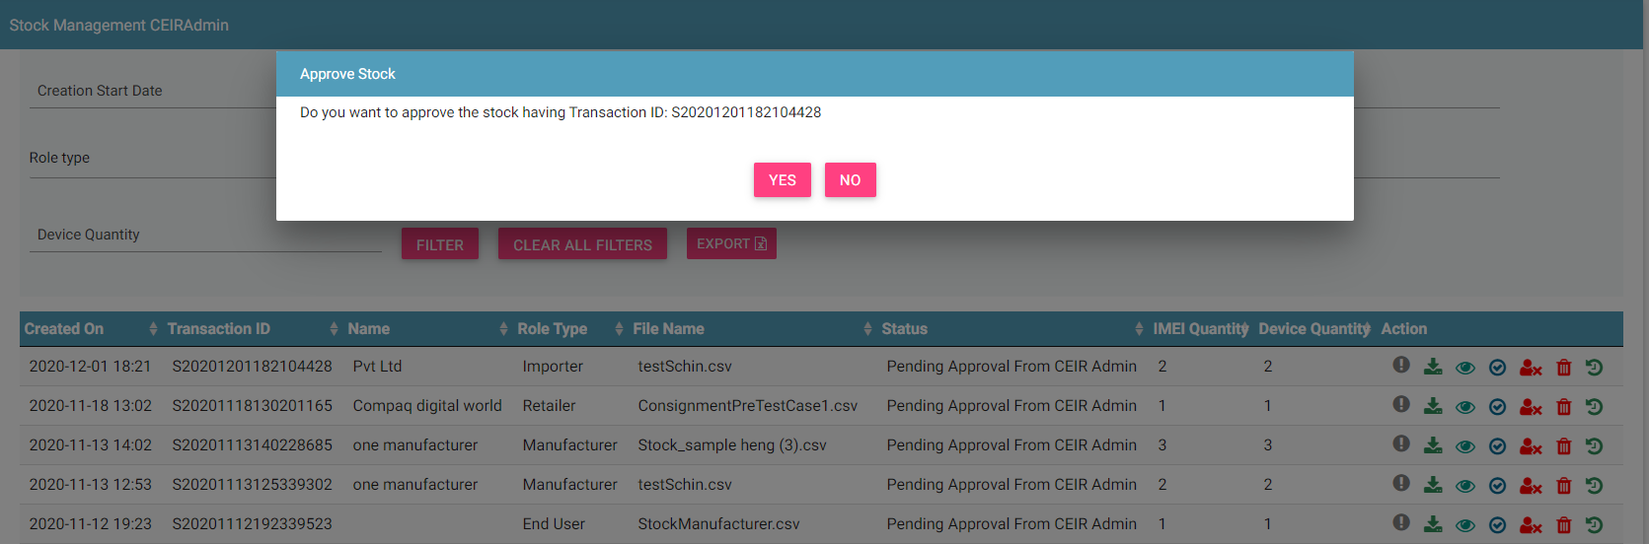
Stock Approved by CEIR Admin
Stock after successful processing are sent to the CEIR Admin queue for Approval / Rejection.
On Approval, stock is finally approved to be used in the network.

Slide 30
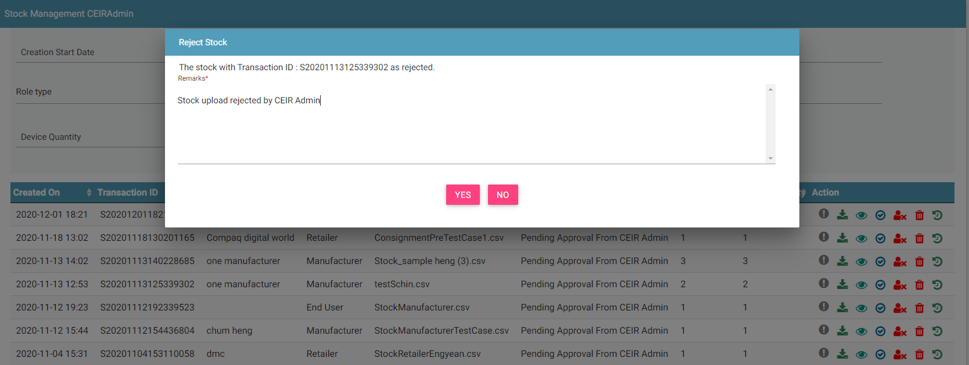
Stock Rejected by CEIR Admin
CEIR Admin has the authority to reject any stock. Remarks have to be updated for the same.

Slide 31
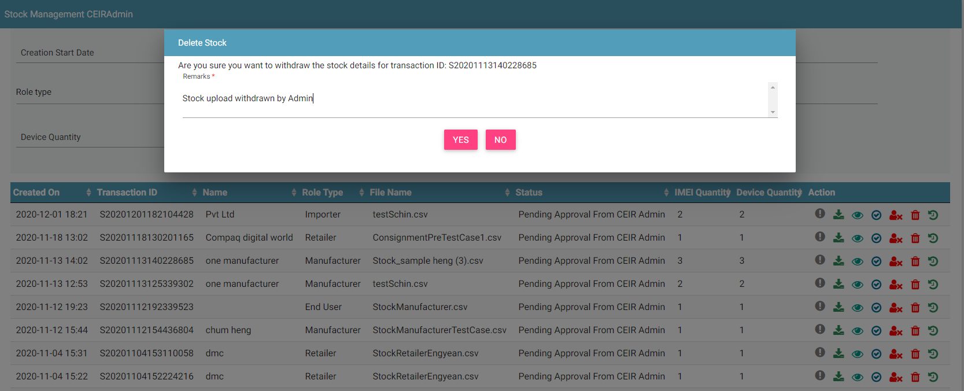
Stock Withdrawn By CEIR Admin
CEIR Admin has the authority to withdraw any stock. Remarks have to be updated for the same.

Slide 32
Filter Stock
Stock can be filtered on the basis of
Date filters
Transaction ID
Stock Status
The User ( Importer/ Retailer/ Distributor/ Manufacturer/ Custom / CEIR Admin) can also use a combination of more than one filters to filter the stock.
Users can view old stock using the date filter.
Clear All Filters can be used to clear filters and refresh the data table.
Export button will export the data based on the filters applied.

Slide 33
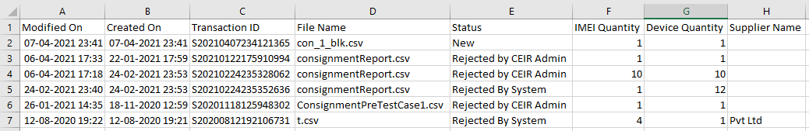
Export Stock
Stock can be exported in a .csv file using the export button.
User ( Importer/ Retailer/ Distributor/ Manufacturer/ Custom/ CEIR Admin) can export all stock assigned to the respective user.
User (Importer/ Retailer/ Distributor/ Manufacturer/ Custom/ CEIR Admin) can export filtered stock.

Slide 34
Policy
Policy for grace and post grace period will be different for stock management for different types of users. More details on same would be discussed in the “Policy Management” Training session
User | Remarks
Manufacturer | Grace Period: Same to what importer has for consignment management Post Grace Period: Same as grace period
Custom | Grace Period: Stock would be regularized if device is found to be invalid. Post Grace Period: Reject the request if device is found to be invalid
Importer | Grace Period: Stock would be regularized if device is found to be invalid. Post Grace Period: Feature not available to user
Retailer/Distributor | Grace Period: Stock would be regularized if device is found to be invalid. Post Grace Period: Reject the request if device is found to be invalid

Slide 35
What next after Approval of Stock?
User | Remarks
Manufacturer | Sell stock to distributor / retailer.
Importer/ Retailer/ Distributor | No impact on any work flow. Only the database is built which is used for policy implementation
Custom | Distributor/Retailer can sell the stock

Slide 36
Queries

Slide 37
Thank You

